Slide 1

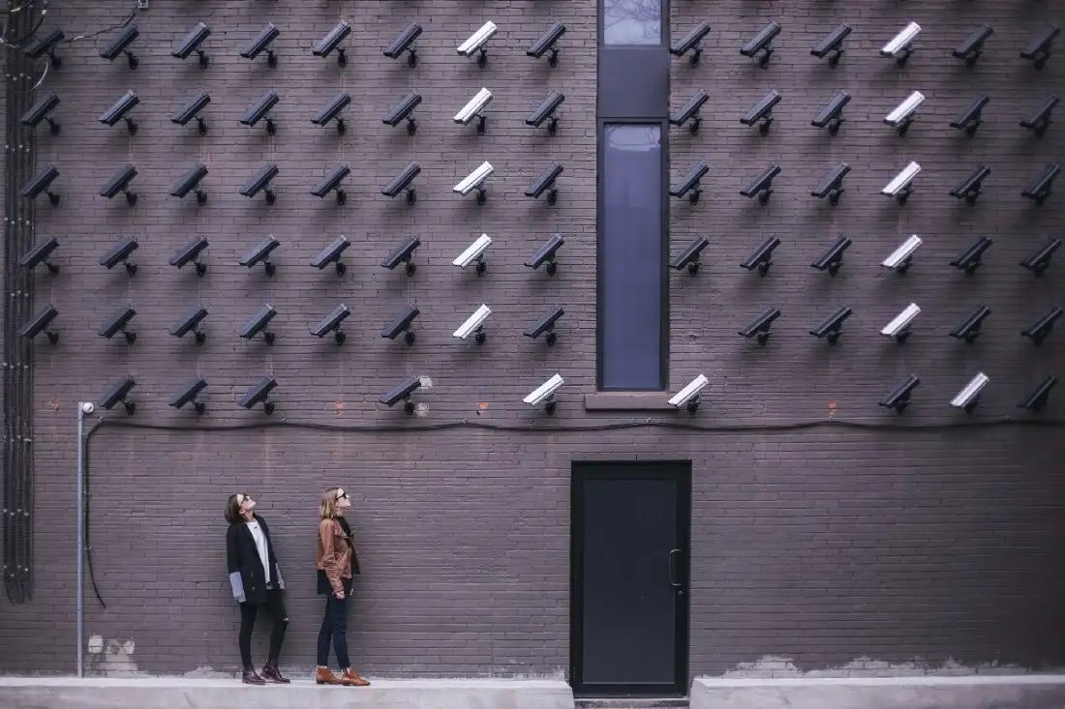
DEV – CCTV Footage Analyzer
Review 3
Team Members:
Mayank Gupta – 20BCE1538

Slide 2
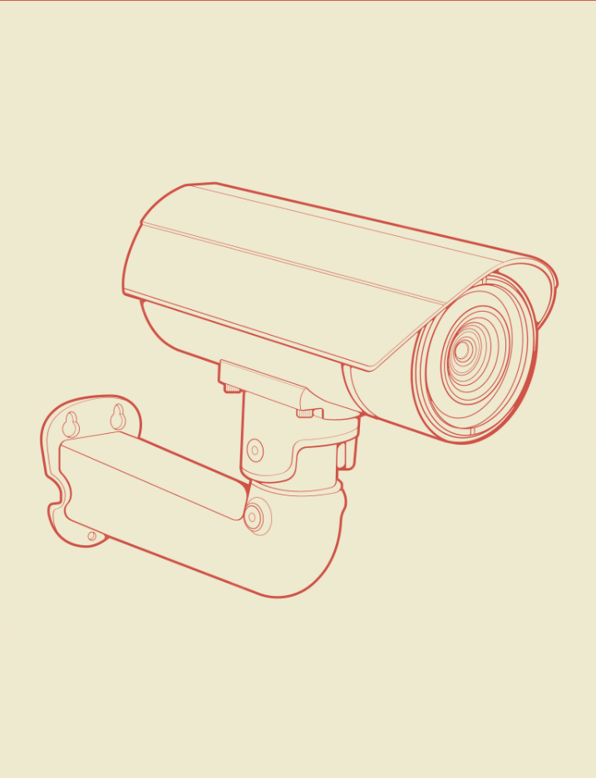
Introduction
• In this project, we aim to develop an algorithm that can automatically analyze CCTV footage and generate captions for selected images. The selected image can be any important event or activity captured by the CCTV camera. The algorithm will analyze the image and generate a caption that accurately describes the activity or event in the image.
• The developed system will be highly beneficial for security and surveillance purposes, as it will enable security personnel to quickly and accurately understand the events captured in the CCTV footage. The system will also be useful for law enforcement agencies, as it will assist in identifying suspects and tracking their movements.

Slide 3
68%
68% of times CCTV footages are useless due to blurred images
80%
Market is going to shift towards automated images enhancing software(CNBC)

Slide 4

Literature Survey
"Deep Learning-based Human Detection in Surveillance Video" by Y. Yang et al.
Shijie, Qiao., Jie, Ma. (2018). A Face Recognition System Based on Convolution Neural Network.
The authors proposed a system that combines object detection and tracking algorithms with a deep learning-based human detection module. The system achieved high detection rates and low false positives, making it suitable for use in surveillance applications
The paper presents a convolution neural network-based facial recognition system with four convolution layers, three pooling layers, one full-connected layer, and one softmax regression layer. Combining the tan(h) and ReLU activation functions yields a new one. ORL Face Database is used to train and test the networks, and the research found that as the number of convolution kernels increases, misrecognition reduces and the new activation function outperforms the other two.

Slide 5

Literature Survey ...contd
"Self-critical Sequence Training for Image Captioning" by S. Rennie et al.
"Real-time Intruder Detection System using Convolutional Neural Network" by K. Kim et al.
"Show, Attend and Tell: Neural Image Caption Generation with Visual Attention" by K. Xu et al.
In this paper a system that uses reinforcement learning to improve the quality of generated captions is proposed. The system achieved improved performance on several benchmark datasets compared to traditional training methods.
The authors developed a system that uses a CNN to classify images as either normal or abnormal, with abnormal images indicating the presence of an intruder. The system achieved high detection rates with low false positives.
In this paper authors proposed a system that uses a neural network with an attention mechanism to generate image captions. The system achieved state-of-the-art performance on several benchmark datasets.

Slide 6

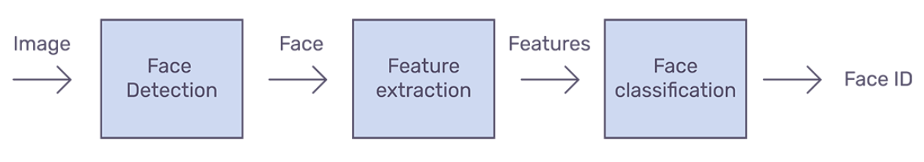
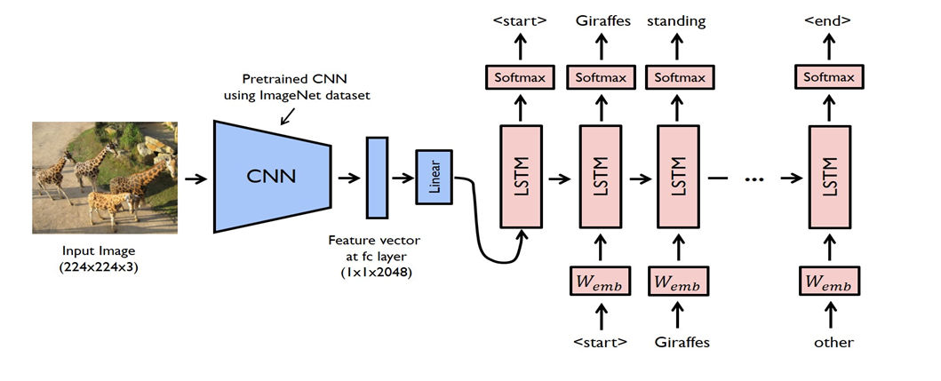
Methodology
Our Model Design
Face Detection
Image Analysis

Slide 7
Part 1: Facial Detection
Step 1
Enhance the colors in the images
Step 3
Search for desired faces in the detected faces
Step 2
Detect faces in the images
Step 4
Display the images with the desired face for further investigation

Slide 8


Facial Identification
Closed Circuit Television (CCTV) is currently used in daily basis for a wide variety of purposes. The development of CCTV has transformed from a simple passive surveillance into an integrated intelligent control system.
In this project images of a person is used as the basis of decision making to identify the frames of the video that has that person in it in an automatic, effective and efficient manner.
While previous methods struggle to restore faithful facial details or extract face identity, our proposed solution with images of a person achieves to detect and mark the presence of the person in a cctv video or images of crowded place. In addition, it allows us to perform restoration and color enhancement jointly, achieving a good balance of realness and fidelity with much less artifacts.
In our case, we feed the feature vectors of the ID image and the test image to the cosine similarity function. Using a threshold, we decide whether the face matches or not.

Slide 9

Video Input
WORKING
Initialize
Show the images
with desired faces
Enhance Images
Recognize faces
Convert to Gray Scale
Detect Faces

Slide 10


Part 2: Describing Image
Image feature extractor
1
Image Captioning
Text Preprocessor
2
3
Output predictor
4
Fitting the Model
5
Caption Generation

Slide 11
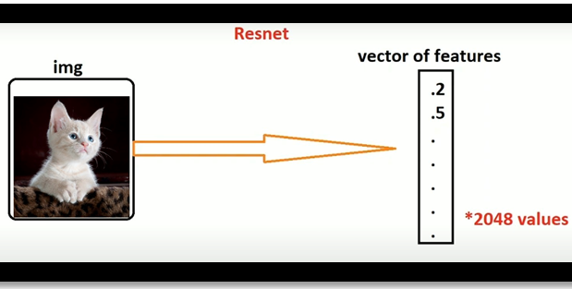
1
Image Feature Extraction
The feature extractor needs an image 224x224x3 size. The model uses ResNet50 pretrained on ImageNet dataset where the features of the image are extracted just before the last layer of classification. Another dense layer is added and converted to get a vector of length 2048.

Slide 12
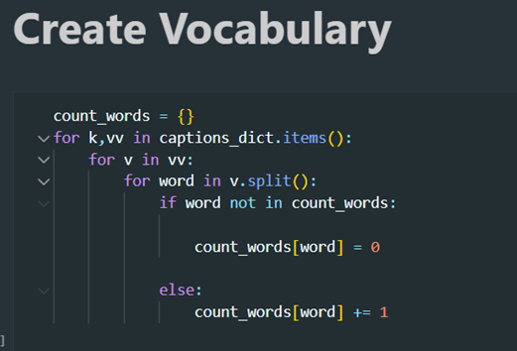
2
Text Preprocessor
Unique words are tokenized from the training dataset. As computers do not understand English words, we have represented them with numbers and mapped each word of the vocabulary with a unique index value and we encoded each word into a fixed sized vector and represented each word as a number.

Slide 13
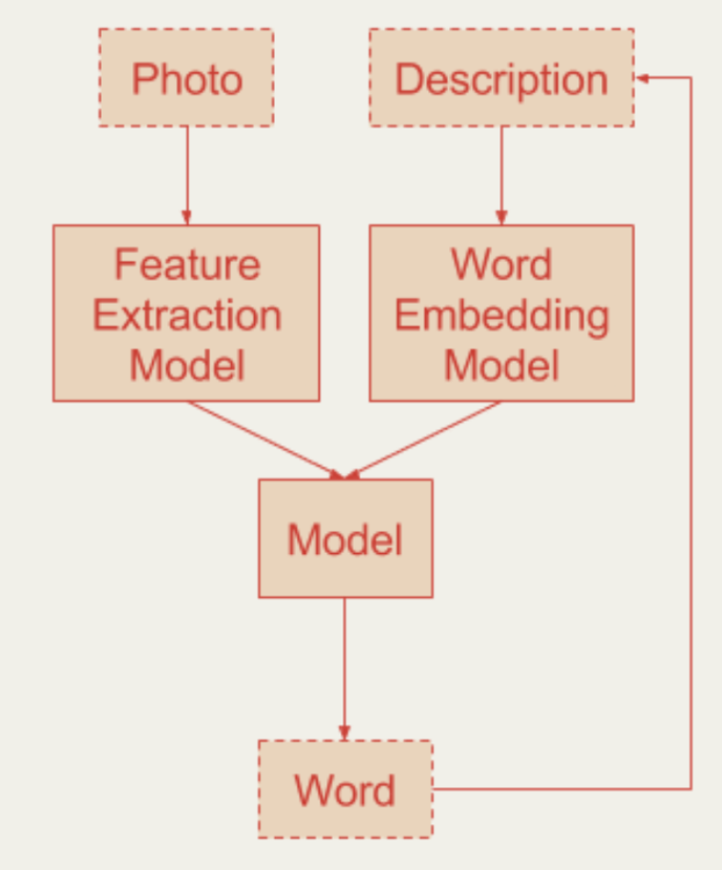
3
Output Predictor
Output vector from both the image feature extractor and the text processor are of same length (128) and a decoder merges both the vectors using an addition operation. This is then fed into two dense layers. This layer uses softmax activation function to predict the most probable next word in the vocabulary.

Slide 14
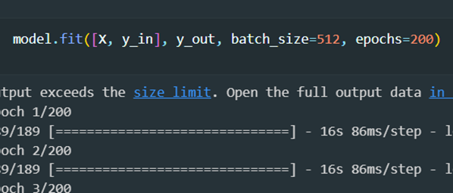
4
Fitting the Model
After building the model, the model is fit using the training dataset. The model is made to run for 200 epochs and the best model is chosen among the 200 epochs by computing loss function on Flickr8k development dataset. The model with the lowest loss function is chosen for generating captions.

Slide 15
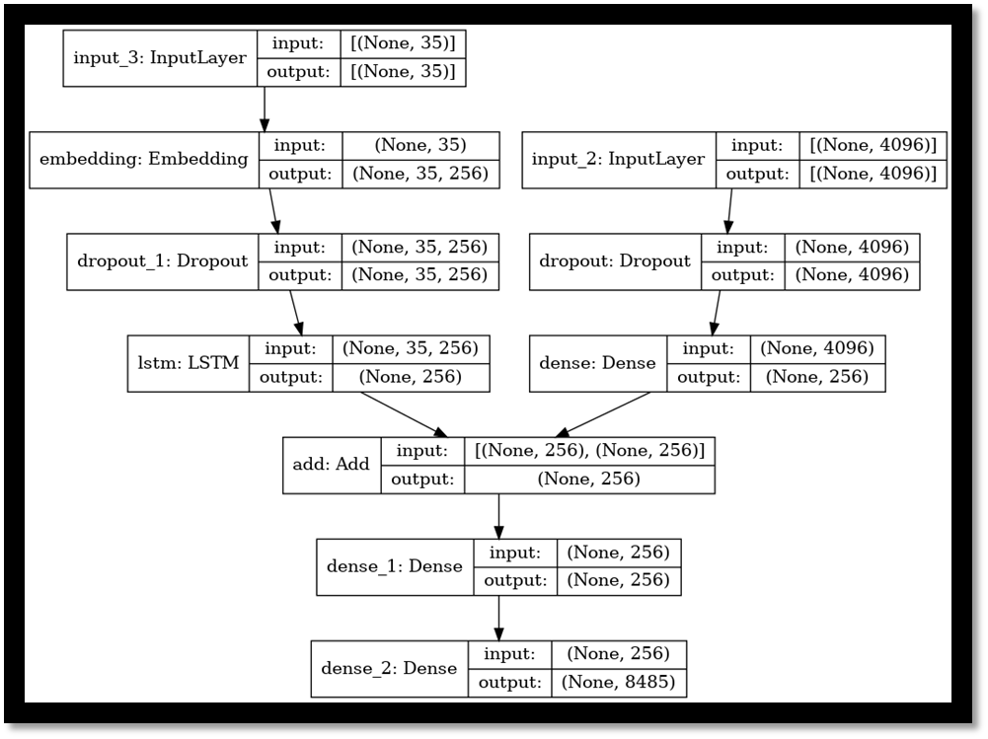
Model Architecture

Slide 16

We use BLUE score It is an algorithm, which has been used for evaluating the quality of machine translated text.
We can use BLUE to check the quality of our generated caption.
BLUE is language independent . It lies between [0,1]. Higher the score better the quality of caption
Performance Analysis
Blue Scores obtained for image captioning
Metric | SCORE
BLUE-1 | 0.2518196
BLUE-2 | 0.0898582

Slide 17

VGGFace2
https://www.kaggle.com/datasets/greatgamedota/vggface2-test
Datasets Used
PyTorch
https://github.com/timesler/facenet-pytorch
Flickr8k
https://www.kaggle.com/datasets/srbhshinde/flickr8k-sau
MTCNN
https://arsfutura.com/magazine/face-recognition-with-facenet-and-mtcnn/
Resnet50
https://iq.opengenus.org/resnet/

